Slide 1


HEAT RECOVERY FROM CO₂ REFRIGERATION SYSTEM IN SUPERMARKETS TO DISTRICT HEATING NETWORK
Lugas Raka ADRIANTO^{1,2}, Pierre-Alexandre GRANDJEAN¹, Samer SAWALHA¹
¹KTH Royal Institute of Technology, Sweden; ²Ecole Polytechnique, France
13th IIR GUSTAV LORENTZEN CONFERENCE ON NATURAL REFRIGERANTS
Valencia, Spain – 18th to 20th of June, 2018
Notes:
Good morning everyone, thank you for having me at this session.
My name is Raka, one of the author on the project entitled “….”, a topic that was conducted in Stockholm, Sweden as the study scope.
At this opportunity, we would like to share the important findings from this project, which we believe might be interesting in the field of refrigeration system heat recovery with its application to district heating network.
Without further ado, we shall proceed with the contents.

Slide 2
Acknowledgements
Danish EUDP ‘Super Supermarkets’ Project
KTH Royal Institute of Technology (Practical Energy Project) Applied Refrigeration Lab
Notes:
A brief remark about the project, as I mentioned earlier: the study started a year ago with some reference were taken mostly from closely related topics at the university as well. Hence, in that sense the research has been taking numerous CO2 refrigeration research from the past studies and evaluation, which appeared to be very helpful in justifying the early process of this study.
In addition, KTH is also one of the university partner in the framework of Super supermarkets project. Therefore, both entities have made their own portion to initiate and drive this project till the very end.

Slide 3
Outline
Introduction and Background
CO₂ as refrigerant in supermarket systems
Objectives
Scenarios definition
Methodology
Energy use and efficiency of the systems
Economic evaluation
Results & Analysis
Conclusion
Notes:
That being said, the outline of today’s presentation is divided into three main parts.
We will first begin by having a closer look on the role and potential of energy recovery in our surroundings. Bear in mind, it only entails a general overview to give us an idea about from where and to where those emitted energy can be exploited.
Of course, by doing a more specific aim on CO2 refrigeration system, it is inevitable to talk about the main philosophy of such system as opposed to other existing refrigeration systems.
Secondly, you will briefly grasp the methodology of this research – generally the overall picture on how we can conduct and complete this study. Thus right after this section, several important results are presented to emphasize certain benefits of employing different scenarios.

Slide 4

Introduction
District
Heating
Excess heat
Supermarkets
Data Centers
Ice Rinks
Ground Temperature in Summer
Excess cold
District Cooling
Supermarket as energy intensive users (Sawalha, 2010)
50% of total energy is consumed by refrigeration system
In an average Swedish supermarket, 17 single-family houses can be provided by this recovered heat (half of 175 kW recovered heat)
Notes:
In restrospect, as we all know the current system runs at the process/ technology in which several possible losses might occur. Simply, it could be in the form of heat losses or ‘cold lossess’, leaking out of the system unutilized. These facts can be overcome by designing a system in such a way to extract/ deliver such energy from each producer to other places (in this case as I show to all of your: district heating/ cooling network).
For the purpose of the study, we identified supermarkets as one of the promising potential due to these facts:
- 50% of its consumed energy is basically dominated by refrigeration system, so to say enourmous amount. Other complementary fact (100-150 kW common supermarket), up to 20 single family houses can benefit the excess heat (eventually raising the overall efficiency of the system, indeed)

Slide 5
Background – Refrigeration Improvements
What if?
Lower GWP (1 vs 3200)
Hypothesis: Lower energy consumption?
Conventional System
Proposed System: CO₂ (R-744)
Trends of supermarket refrigeration systems
CO₂ trans critical system yield high efficiency and can recover heat for space heating demand in the supermarket (Sawalha, 2013)
Notes:
With that criteria and objectives in mind, what can we do about it?
The trend shows that CO2 as refrigerant medium has been gaining popularity due to its harmless chemical (measured by its GWP 1 vs 3200 of normal refrigerant) and possibly lower energy consumption. The first one was undoubtedly validated, yet how about the second one?
Moreover, if we take into account the generation of excess heat to the network that implies the addition of more heat exchangers into the basic configuration.
These questions and some curiosities lead us to the

Slide 6
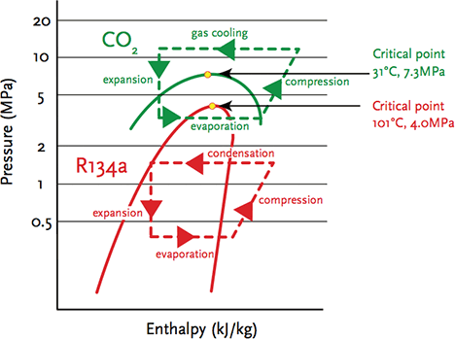
Objectives
Techno-economic analysis of CO₂ refrigeration with optimum heat recovery scenario
Correlate the production of heat from supermarkets to utility network providers
Determine the gained savings from different scenarios
Notes:
It leads us to the objectives of the study, constituting mainly by two techno-economic analysis:
We want to model such systems so that it is possible to transfer heat from the supermarkets to the district heating/ utility network providers. Therefore, some parameters such as price of buying/ selling heat from the utility should be identified as well.
Our study also includes the importance of varying the refrigeration systems with multiple scenarios. Henceforth, at last the best/ optimized scenario can be taken as a candidate to substitute the existing systems – justified by its advantages and economic benefits.

Slide 7
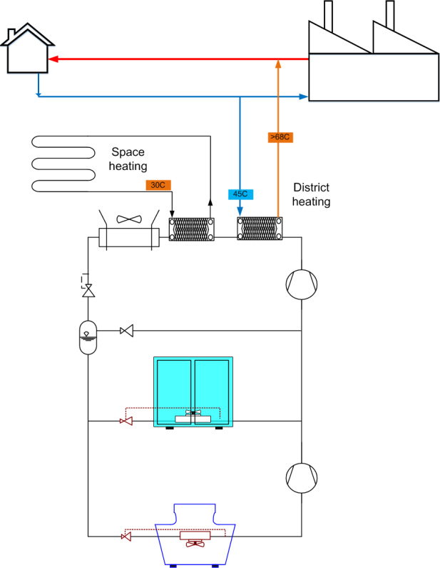

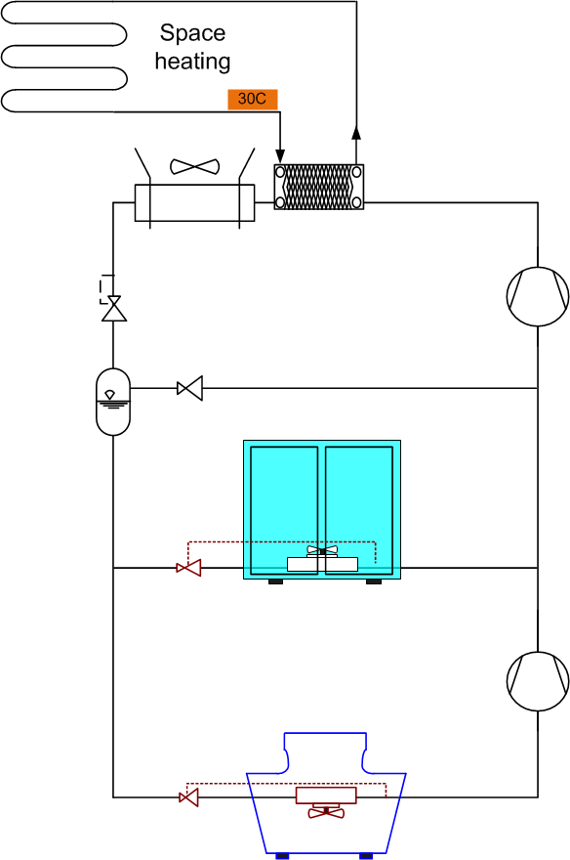
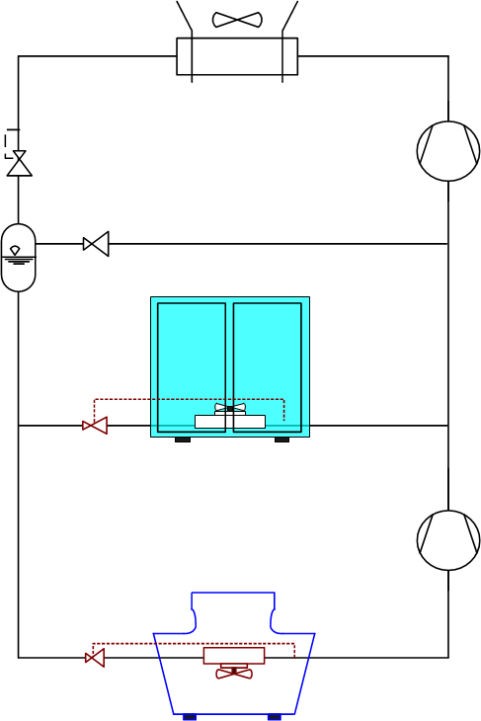
Scenario Definition: 1st, 2nd, and 3rd
Space
heating
Space
heating
District heating
Heat Pump
P
FC + DH (base)
FC + HP
SH Only
These cases are differentiated by the method to supply space heating
Notes:
As talked earlier, 5 scenarios are presented here to show the distinctions between one to another in these simplified flow charts.
The first three do not have the particularity of delivering the heat to the utility providers. Instead, the default case purchases the amount of heat to fulfil its internal space heating demand from DH network while operating normally with one condenser. 2nd one has almost the same configuration, but the DH network role is replaced by a groundsource heat pump to generate space heating needs. The 3rd has a major difference by pushing the pressure higher than the previous two, with the goal to have sufficient heat for internal heat consumption.

Slide 8
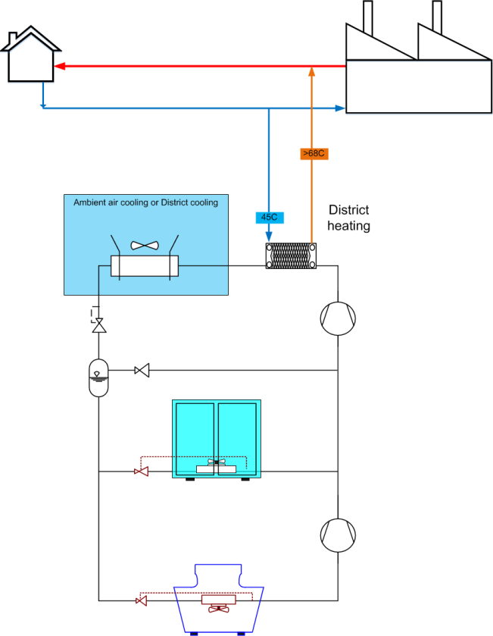
Scenario 4th and 5th
District heating
District heating
DH (SH Priority)
DH Only
These scenarios allow the selling of excess heat to district heating network
Notes:
And now, in the last 2 we are talking about the selling of excess heat from supermarkets to the district heating network.
The fourth scenario still adopts the same heat exchangers purpose to utilize heat internally in the supermarket. However, an additional heat exchanger (2nd exchanger) is installed before to accommodate heat delivery to the utility. It should be noted that SH still remains as the priority here, meaning that if condition does not allow (for instance at low pressure level), then limited/ no energy can be sent to the network.
On the other hand, DH only scenario lays the concept of setting a single exchangers solely dedicated for DH network.

Slide 9
Methodology
Technical
Refrigeration cycle
Computer aided simulation (EES®)
Economic
Utility’s heat selling and buying price (Stockholm case)
Comparison
Energy use
COP heat recovery
Cost of producing heat (Ch)
COP_{HR} → core concept: the amount of heat recovered for certain amount of work added
Ch → cost of electricity divided by COP_{HR}
Notes:
With all those configurations, this simple working process is presented to elaborate the ideas behind our study.
In terms of technical side: we modelled the system (each with different scenario and configuration) using a computer aided simulation, including its thermodynamic parameters. The results of this technical part is further processed by incorporating economic parameters such as the price of heat/ electricity, to determine the cost of producing and operating the systems.
Two useful variables are displayed here:
Coefficient of performance HR: with the essence of correlating the amount of heat recovered for certain amount of kW work required
Apart from this, we also want to know the cost of generating heat – hence, it can be comparable with the price of buying heat from utility network.

Slide 10
Results (I) – Energy Use
SH only scenario needs higher power consumption due to a higher operating pressure (it increases even more for DH (SH priority)
A study of COP should be conducted to have equal comparison
Notes:
Higher compressor power for SH only due to higher discharge pressure to facilitate heat recovery system.
DH(SH priority) even boosts the discharge pressure even higher in order to supply heat for district heating network.
FC only and FC+HP have the same curves (the reason it is not shown).
DH only has relatively the same pressure (set at P1=85 bar).

Slide 11
Results (II) – Heat Recovery COP_{HR}
High efficiency: COP range from 4 – 8 for DH with SH priority
Low efficiency: supplying excess heat to district heating only (COP ~2.5)
Notes:
In average for three modified scenarios with three heat recovery cases, they yield COP HR between 3-8 (minimum at around 2.5).
The green line representing COP limit is put to gauge the difference between theoretical value to obtain profit. Anything above this curve generates profit after receiving revenue from the utility provider in exchange of selling excess heat.
DH (SH priority) looks to be the most superior with COP reaching 8, while DH only is the worst scenario even generating loss of money due to its inefficiencies at temperature higher than -5 C.

Slide 12
Results (III) – Cost for Producing Heat
$$Utility heat offer>\frac{Electricity Price}{COP_{ HR}}or Heat Generation Cost$$
Notes:
The main reason behind this would be due to the fact that the cost of generating heat for district heating networks is less than the price that Fortum is willing to pay.
For this particular case with different T outdoor, it can be seen that SH+DH scenario outperforms DH only case since the supermarket can gain profit at this window of temperature(between 1 and -15 C).
Whenever Fortum price > cost of producing heat, the supermarket reaps benefit out of this heat recovery process.

Slide 13
Results (IV) – Energy Cost Comparison
Cost reductions: Mainly generated from savings of space heating demand (3rd and 4th scenario)
Notes:
Aligning with the previous results, here is the chart for equally comparing different scenarios (in total 5 of them).
Obvious messages:
Supermarkets should always recover heat for its internal space heating demand (huge savings of 30% only by implementing this)
On top of that, selling to DH can be an additional revenue bonus to further increase the positive margin (particularly if the price being offered is favourable and interesting from the seller side)
DH only makes no profit at all or even deficit because more expenses have to be spent from DH but the profit could not offset the total costs. In this case, it is not recommendable to operate the system to sell and buy heat from DH network separately, especially if the pressure level is not optimized yet (fixed value at all conditions).

Slide 14
Conclusions
This study gives some takeaways:
Best scenario
Recover heat for space heating in the supermarket as a priority and then deliver the remaining heat to district heating (DH(SH Priority))
COP_{HR} = in average 4.5
It yields the lowest energy costs, roughly 40% less than the base scenario
Alternative scenario
The 2nd lowest energy costs has been obtained for SH only scenario – recovering heat for space heating provides the most benefit apart from selling to the network
“Selling to DH” scenario
Due to low price offered by utility and poor efficiency of the system, DH only scenario becomes the worst scenario (not profitable) – COP_{HR} = 2-3
Costs of producing heat is higher than the profit of selling (eventually resulting in 10% more expensive than the base scenario)
Notes:
Having heard all the essential findings in this study, these three conclusions can be drawn:
1st and 2nd take away: prioritization of SH heat recovery in the supermarket (it is evident that the buying of heat from DH network can be substituted by own heat production). Up to 40% can be reached by combining SH only and selling to DH network scenario as the extra case if remaining excess heat is still available from the refrigeration system.
3rd takeaway: DH only scenario does not depict a bright result (lowest COP in all operating conditions). The main reason: more bill is needed to pay heat for space heating demand, than the amount of revenue being obtained by trading excess heat with utility provider.

Slide 15
THANK YOU Questions?
Lugas Raka ADRIANTO^{1,2}, Pierre-Alexandre GRANDJEAN¹, Samer SAWALHA¹
¹KTH Royal Institute of Technology, Sweden; ²Ecole Polytechnique, France
adrianto@kth.se
Notes:
I would like to appreciate all of you for listening to our project.
If you have doubts, I hope I can clear them for you during questions and answering sessions.
In any case, thank you very much!

